Slide 1
Operational Design

Slide 2
Really for LT & CPTs ??

Slide 3
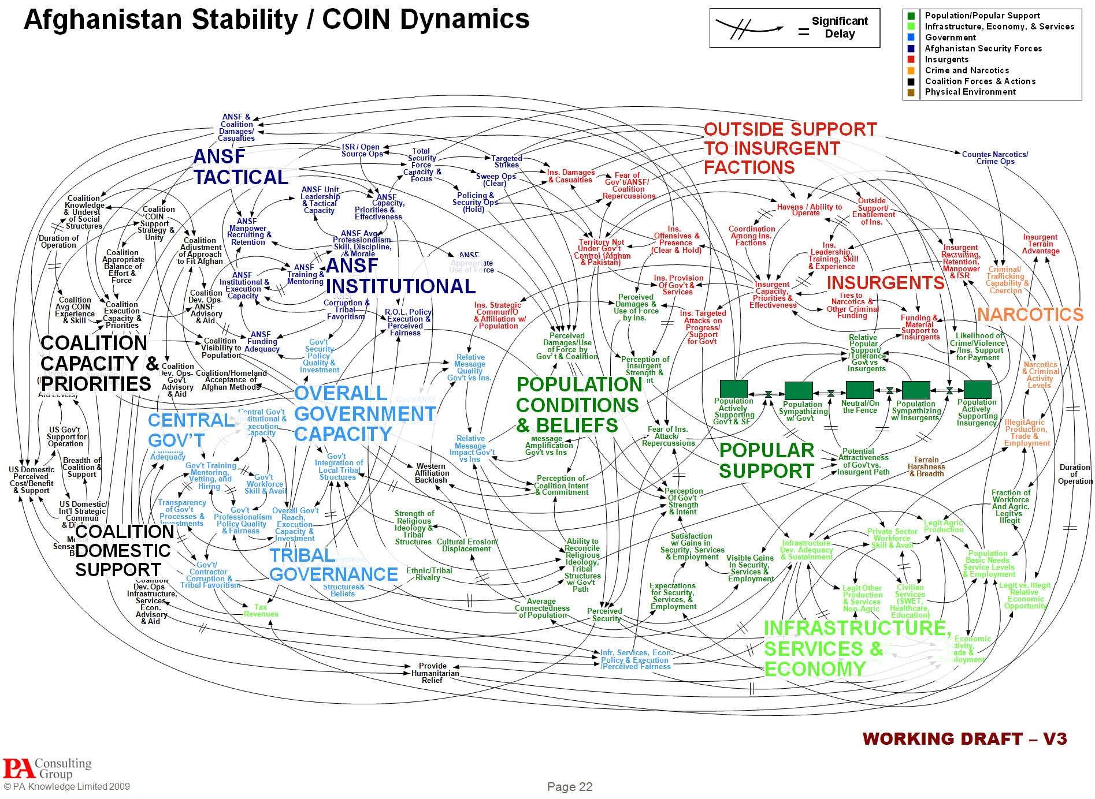

Slide 4
Easy Turbo

Slide 5
Don’t Stress !

Slide 6
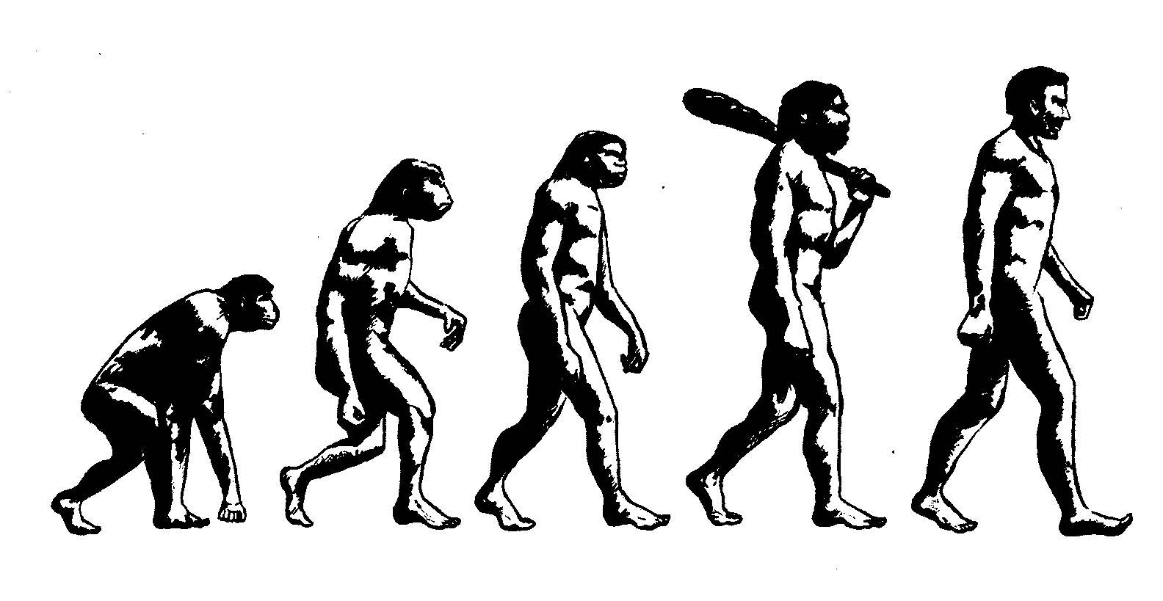
Crawl before we can walk

Slide 7







































ACSC Operational Design Guide
CURRENT SITUATION
LINES OF OPERATION
OPERATIONAL OBJECTIVES
CAMPAIGN OR OPERATIONAL END STATE
MILITARY STRATEGIC END STATE
NATIONAL STRATEGIC END STATE
What are the current conditions?
What does the operating space ‘look like’?
Is there a problem?
What is the problem?
What do we need to change to achieve the end state?
What needs to stay the same?
The alignment or grouping of decisive points results in developing lines of operations, which connect the decisive points over time and space towards the operational objective.
The overall end state may be too broad or vague to deal with, therefore, it can be broken into smaller elements that can be described separately (mini end states). These are operational objectives. The achievement of the sum of the operational objectives results in the achievement of the end state.
Determining the campaign or operation end state involves analysing the superior commander’s intent and national or military strategic objectives
A clearly defined end state promotes unity of effort, facilitates integration and synchronisation and helps manage risk..
Military strategic end state is the set of desired conditions beyond which the use of military force is no longer required to achieve national strategic objectives.
DESIRED END STATE:
What is the overall national aim?
What are the national policies?
DESIRED END STATE:
What does the operating space ‘look like’?
What are the conditions necessary to achieve the goals?
What needs to change and what needs to stay the same?
A line linking decisive points to allow sequential progression towards an operational objective or the desired end state.
A condition that needs to be achieved during a campaign or operation to enable the desired end state to be reached.
The political and/or military situation to be attained at the end of a campaign or operation, which indicates that the objective has been achieved.
PMC (Prime Minister & Cabinet)
JOC (Joint Operations Command)
POL OBJ
POLITICAL STRATEGIC ENDSTATE
What is the right problem to solve?
What is the aim – environment & actors?
Frame the problem
OBJ
Decisive Points
Lines of Operation
POL OBJ
CURRENT MILITARY SITUATION
1
2
3
4
OP OBJ
OBJ
Effects = Task and Purpose for a tactical outcome
MSC (Military Strategic Commitments)
5
2
6
7
8
OP OBJ
OPERATIONAL ENDSTATE
MILITARY STRATEGIC ENDSTATE
OBJ
GRAND / COALITION / NATIONAL STRATEGIC ENDSTATE
Effect (task and purpose)
Effect (task and purpose)
Effect (task and purpose)
Sequel
13
14
15
OP OBJ
OBJ
Commander’s Decision Point
3
9
10
11
12
OP OBJ
Branch
ECONOBJ
ECONOMIC STRATEGIC ENDSTATE
OBJ
16
17
18
ECONOBJ
OBJ
DECISIVE POINTS
In planning there are conditions that must be set in order to realise the end state and/or the operational objectives. These conditions are the decisive points. In articulating decisive points, think in smaller tangible conditions that build and thereby lead to the operational objective and thence end state. You must plan to achieve the decisive points – allocate resources effectively – needs to take into account risk, branching, sequencing. Analysis of decisive points will determine: What effects are needed – what do you need to do to change the conditions? What capabilities are needed to achieve the effects? When the effects are needed by? Threats to achieving the desired effects? This leads to tasks to components, or joint capabilities.
Must be measurable; distinguishable; linked directly to objective/s. Effects are subsets of DPs and articulate ‘task and purpose’ to subordinate formation/s. DPs are things that you are willing to contest, to fight for…
BRANCH
SEQUEL
CENTRE OF GRAVITY (COG)
MAIN EFFORT
An option at a Commander’s Decision Point (CDP) along a line of operation that allows the commander flexibility to anticipate decisive points by deviating from, and returning to, that line of operation.
An option at a Commander’s Decision Point (CDP) along a line of operation, initiated by a significant shift in operational direction, which identifies a new line of operation to achieve a revised or new objective.
The primary entity that possesses the inherent capability to achieve an objective otr the desired end state.
Thing or those things (noun) that enable an actor to achieve their end state or stop others achieving theirs.
There can be more than one CoG.
All actors potentially have CoG.
A concentration of forces or means, in a particular area, time and phase of an operation, where a commander seeks to bring about a decision.
The ME may be a DP or the main LOO during that particular phase. It is what the commander thinks is going to be decisive and it provides the focus for the activity that is considered to be crucial to success in the campaign or operation …
A significant operational milestone that exists in time and space or the information domain which constitutes a key event, essential task, critical factor or function that, when executed or affected, allows a commander to gain a marked advantage, or contributing to achieving success.
References:
1. Department of Defence, ADDP 3.0 Campaigns and Operations, Edition 2, 12 Jul 12, Defence Publishing Service, Canberra, ACT.
2. Department of Defence, ADDP 5.0 Joint Operations Planning, 2014, Defence Publishing Service, Canberra, ACT.
3. Department of Defence, ADFP 5.0.1 Joint Military Appreciation Process, Edition 2, 24 Feb 15, Defence Publishing Service, Canberra, ACT.
Version: 4
Author: JOP Team

Slide 8
Operational Plan
Line of Operation
Line of Effort
Line of Effort
Line of Effort
Ways
Ends

Slide 9
References
ATP 5-0.1 [Army Design Methodology] (July 2015)

Slide 10
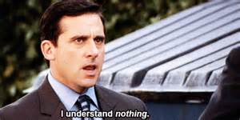
Scope
ADM integration
Operational Art
Assigning the Team
Templates
Steps 1-4
Examples

Slide 12
Integrating planning methodologies
Effective planning requires integrating at all levels. The following planning methodologies are used throughout an Operation.
ADM - ??
MDMP – kind of all over it ?? Familiar - experienced
TLP – over all it!! Mastery

Slide 13
Design & MDMP

Slide 14
Design & MDMP
Design – Supports Conceptual planning focused on “ill-structured” problems.
MDMP – Supports Conceptual, Functional, & Detailed planning focused on “ill-structured,” “medium structured,” and “well structured” problems. Produces a FRAGO/OPORD.

Slide 15
When to use ADM and why?

Slide 16
Army Design Methodology
Army design methodology is for applying critical and creative thinking to understand, visualize, and describe problems and approaches to solving them.
Army design methodology is particularly useful as an aid to conceptual planning, but must be integrated with the detailed planning typically associated with the MDMP to produce executable plans.
Key concepts that underline the Army design methodology include—
Operational Art
Critical and creative thinking.
Collaboration and dialogue.
Framing.
Narrative construction.
Visual modeling.

Slide 17
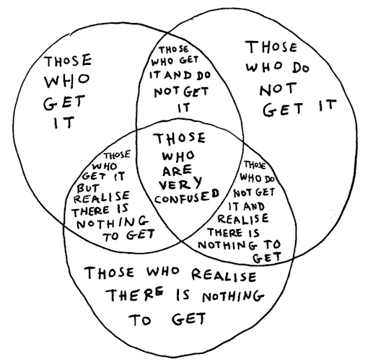
Operational Art

Slide 18
Operational Art

Slide 19
Operational Art

Slide 20
Ways
Means?
Ends

Slide 21
Step 1
Gather the Tools

Slide 22


Slide 23
Assigning your team

Slide 24
Team Roles

Slide 25
Team Roles

Slide 26
Encouraging dialogue

Slide 27
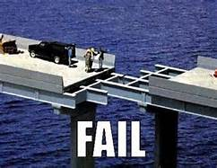

Template for Design

Slide 28
Overall Template for Design
1
Environmental Frame, part 1
2
Environmental Frame, part 2
“What is going on in the environment?”
The history, culture, current state, and future goals of relevant actors in the operational environment
“What do we want the environment to look like?” A sought-after future state of the operational environment
Answered by means of a graphic and prose.
Answered by means of a graphic and prose.
Narrative
Narrative
Graphic
Graphic
3
Problem Frame
4
Operational Approach
“What is our Problem Statement or Problem Set?”
“Where—conceptually--should we act to achieve our desired state?” Areas of tension and competition—as well as opportunities and challenges—that commanders must address so to transform current conditions to achieve the desire end state
“How do we get from the current state to our desired state?” possible combinations of actions to reach the desired end state given the tensions identified in the environmental and problem frames
Answered by means of a graphic and prose.
Answered by means of a graphic and prose.
Narrative
Narrative
Graphic
Graphic
Notes:
“What is going on in the environment?” is a colloquial way to prompt the design practitioners to capture “the history, culture, current state, and future goals of relevant actors in the operational environment” (ADRP 5-0, para 2-34).
“What do we want the environment to look like?” is a colloquial way to prompt the design practitioners to posit “” ( ADRP 5-0, para 2-38).
“Where—conceptually--should we act to achieve our desired state?” is a commonsense way to prompt the design practitioners to reflect on those “areas of tension and competition—as well as opportunities and challenges—that commanders must address so to transform current conditions to achieve the desire end state” (ADRP 5-0, para 2-40).
“How do we get from the current state to our desired state?” is a commonsense way to prompt the design practitioners to envision those “possible combinations of actions to reach the desired end state given the tensions identified in the environmental and problem frames.”
Design practitioners should communicate their answers to the four questions in both graphic an narrative form.

Slide 29
Step 2
Environment Frame

Slide 30
Framing
Framing the environment is essential to ensuring commanders identify the right problem to solve. Effective application of the Army Planning Process is the difference between solving a problem right and solving the right problem.
Einstein supposedly said that if he had one hour to save the world he would spend fifty-five minutes defining the problem and only five minutes finding the solution.

Slide 31
Environmental Frame, part 1
Take into consideration . . . (among other things)
Tendencies: the likely pattern of the relationships if we don’t intervene (consider tendencies in light of specific relationships and in the aggregate)
Potentials: the inherent ability or capacity for the growth or development of a specific interaction or relationship (consider potential in light of specific relationships and in the aggregate
Guidance
Histories and cultures
Actors (any persons, institutions, bureaucracies, organizations, groups, communities, etc. that have relevant interests or influence)
Actors’ goals
Relationships among the actors
The operational variables
Potential i
Potential ii
Potential iii (and the likely trend)
Potential iv
b) Posit an answer to the question . . . .
“What is going on in the environment?”
time
Narrative
Graphic
Note: This frame is a simplification of reality. This simplification is important. Lives and resources will depend upon whether our view of reality as communicated in the environmental frame is better or worse. Keeping in mind the need to simplify, the more actors’ perspectives we consider, the better. The more relationships we consider, the better. Moreover, given the operational environment’s complexity, the more expertise we consider, the better. For instance, if governance, economic development, or reconciliation will at some point constitute lines of effort, it might help for someone to know something about politics, economics, and sectarian conflict. Doctrine touches upon such topics; however, doctrine does not instruct about such topics.
Notes:
“An actor is an individual or group within a social network who acts to advance personal interests. Relevant actors may include states and governments, multinational actors such as coalitions, and regional groupings, alliances, terrorist networks, criminal organizations, and cartels. They may also include multinational corporations, nongovernmental organizations, and other actors able to influence the situation either through, or in spite of, the appropriate civil, religious, or military authority”.
“Tendencies are not considered deterministic but as models describing the thoughts or behaviors of certain actors. Tendencies identify the likely pattern of relationships between the actors without external influence. Once identified, commanders and staff evaluate the potential of these tendencies to manifest within the operational environment. Potential is the inherent ability or capacity for the growth or development of a specific interaction or relationship”.
“Often, learning about the nature of the situation helps them to understand the groupings, relationships, or interactions among relevant actors and operational variables. This learning typically involves analysis of the operational variables while examining the dynamic interaction and relationships among the myriad other factors in the operational environment.

Slide 32
Current State of the OE

Slide 33
Narrative

Slide 34
Environmental Frame, part 2
Take into consideration . . . (among other things)
-Tangible conditions
Intangible conditions
Military conditions
Non-military conditions
Perceptions
Levels of comprehension
Cohesion among groups
Relationships between actors
Guidance from higher
Time available
Duration of desired end state
b) Posit an answer to the question . . . .
“What do we want the environment to look like?”
Narrative
Graphic
This narrative includes a description of our desirable conditions.
Notes:
“The desired end state consists of those desired conditions that, if achieved, meet the objectives of policy, orders, guidance, and directives issued to the commander. A condition is a reflection of the existing state of the operational environment. Thus, a desired condition is a sought-after future state of the operational environment.
Since every operation focuses on a clearly defined, decisive, and attainable end state, success hinges on accurately describing those conditions. These conditions form the basis for decisions that ensure operations progress consistently toward the desired end state”.
“Time is a significant consideration when developing the desired end state. How time relates to the desired end state heavily influences not only the expectations of higher authorities but also how commanders use forces and capabilities to achieve desired conditions. Staffs exercise diligence throughout design to account for the expected time required to achieve the desired conditions. They also qualify whether the desired conditions are intended to be lasting or transient in nature. This temporal dimension is essential to developing effective operational approaches”.

Slide 35
Desired End State

Slide 36
Narrative

Slide 37
Techniques

Slide 38
Current vs Desired

Slide 39
Step 3
Problem Frame

Slide 40
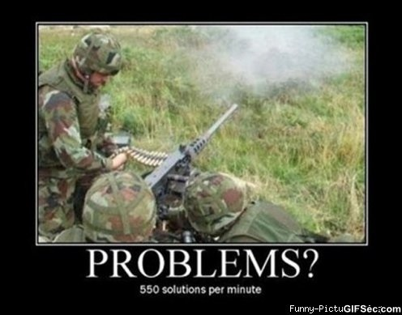
Problem Frame

Slide 41
Problem Frame
best-case scenario
Take into consideration . . . (among other things)
Hypothesized range of outcomes if we exploit and mitigate the right tensions
Root causes
Tendencies
Potentials
Areas of tension and competition within the environment (tension is the resistance or friction among and between actors)
Determine which tensions are positive, neutral, or negative relative to our desired end state
Identify those tensions we can exploit to drive change
Identify those tensions we must mitigate
Potential
Trend if we don’t intervene
Potential
worse-case scenario
b) Posit an answer to the question . . . .
“Where—conceptually—in the environment should we act to achieve our desired state?”
time
Narrative
Graphic
c) Next, specify a problem statement or problem set that reflects our thinking about the difference between current and desired conditions. Judgment is important here! The problem statement describes in a declarative sentence where—conceptually—in the current environment we believe our organization should act in order to achieve a more desirable state. It sets the stage for the next frame.
Notes:
“The problem frame extends beyond analyzing the interactions and relationships in the operational environment. It identifies areas of tension and competition—as well as opportunities and challenges—that commanders must address so to transform current conditions to achieve the desired end state. Tension is the resistance or friction among and between actors. The commander and staff identify the tension by analyzing the relevant actors’ tendencies and potentials within the context of the operational environment” .
“The commander and staff challenge their hypotheses and models to identify motivations and agendas among the relevant actors. They identify factors that influence these motivations and agendas. The commander and staff evaluate tendencies, potentials, trends, and tensions that influence the interactions among social, cultural, and ideological forces” .
“In the problem frame, analysis identifies the positive, neutral, and negative implications of tensions in the operational environment given the differences between existing and desired conditions. When the commander and staff take action within the operational environment, they may exacerbate latent tensions. Tensions can be exploited to drive change, so they are vital to transforming existing conditions. If left unchecked, other tensions may undermine transformation and must be addressed appropriately. Because tensions arise from differences in perceptions, goals, and capabilities among relevant actors, they are inherently problematic and can both foster and impede transformation” .
This is key! “By deciding how to address these tensions, the commander identifies the problem that the design will ultimately solve” .

Slide 42
Problem Frame

Slide 43
Questions you ask?

Slide 44
Map out relationships

Slide 45
Design – Problem Statement TTP Narrative
How can CJTF-HOA posture to assist our East African and IGO partners in conducting humanitarian assistance operations following an El Nino-related disaster with limited resources and authorities given an uncertain environment?
How does __(Who)__
Conduct __(What)__
Given __(Environment)__
With __(Challenges/Constraints)__
Within __(Timeline)__

Slide 46
Narrative

Slide 47
Step 4
Develop an Operational Approach

Slide 48
Operational approach

Slide 49
Operational Approach

Slide 50
Activities

Slide 51

Center of Gravity

Slide 52
Id Decisive Points

Slide 53
LOO & LOE

Slide 54
Lines of Operations / Effort
Line of Operation is a line that defines the directional orientation of a force in time and space in relation to the enemy and links the force with its base of operations and objectives.
Line of Effort is a line that links multiple tasks using the logic of purpose rather than geographical reference to focus efforts towards establishing operational and strategic conditions.

Slide 55
Differences

Slide 56
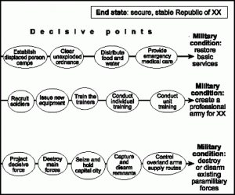
DP synched with LOE

Slide 57
Result

Slide 58
How do you measure
measure of effectiveness is a criterion used to assess changes in system behaviour, capability, or operational environment that is tied to measuring the attainment of an end state, achievement of an objective, or creation of an effect. MOEs help measure changes in conditions, both positive and negative. MOEs help to answer the question “Are we doing the right things?”
measure of performance is a criterion used to assess friendly actions that is tied to measuring task accomplishment. MOPs help answer questions such as “Was the action taken?” or “Were the tasks completed to standard?” A MOP confirms or denies that a task has been properly performed. MOPs are commonly found and tracked at all levels in execution matrixes. MOPs are also commonly used to evaluate training. MOPs help to answer the question “Are we doing things right?”

Slide 59
Other tools

Slide 60
LX | Political | Military | Economic | Social | Infrastructure | Information
Area | KA, MU, UN, FPFA Countries LI, LX | LX,MEZ, FPDA countries, reg countries, (KA for retaliation), BA (reinforcement) | CSL, LX (natural resources), SPODS/APODs for trade. KA supports LX economically | No delineation of central concentration of Pro LX / KA | Road networks, APODS, SPODs, hospitals, power supply | Radio, TV, print media, internet, word of mouth
Structures | Districts, electorates, Influence areas Tribal? | KMF in RKH, GLD, MT Morgan (2 X BDE) SF Bn 2 x SQN F-16/C Surface strike grp Sub surface strike Grp MEU | Trade through GLD (CSL), RKH (APOD) Rural feed the town centres | Putanga vs Southa sympathizers. PFFL Putanga sympathizer RLPF –serve the pop Southa? Can be swung | 3rd world country poor quality roads, no rail networks. Main infra IVO RKH / GLD | Mob phone, TV stations, radio stations, internet
Capabilities | Minor governance, Limited security maintenance. Southa heavily influence reliant on KA. Corruption Putanga backed by UN/AS Clan Based justice system | MEU, Mar ptl, surface strike, subsurface strike, SF strike, recon, engr, log 2 line, BG AMO capability, light motor Bde | Restricted, reliant on KA for exports. Reliant on CSL and trade to SE Asia. Limited internal lofC | RLPF – centered on pop centres Minor policing /limited Para force PFFL – reg, urban fighters and aux. Challenge upto PL size Minor inf tactics | Limited LofC, intermittent power supply, limited medical support. Limited communications centered pop centres | Minor and basic information, limited to radio, TV and print media and word of mouth.
Organisation | Political Parties Southa, Putanga KA President Gen Rashidi UN | KMF, Para RLPF IPM SOKA PFFL KA Police | Banks, Money lenders Mining companies Shipping companies Forestry Tourism | Pro Putanga Pro Southa Pro LGX Nat Pro KA alignment Clan based justice syste | Natural resource companies Local Banks Local Transport Local Shipping Local mining | Media owners Telecommunications networks Internet providers Mayors Local Mullahs
People | Prime minister Parlament Governor Mayors | FPDA KMF Comds IPM Leaders SOKA leaders PFFL leaders | Bankers Farmers Miners Foresters Tourism operators | Edith Cowan ( Lawyer) PWPS – Mona Mira (violence against woman/children) | Local labourers Builders Local transport operators | Website oeprators Radio operators TV presenters Mayors RLPF
Events | Exile of Putanga Req by Southa for KMF assistance Mona Mira – req assistance to FPDA, UNHCR | KMF build up in LGX IPM kidnap 4 x FAW SF neutralise the PFFL KA Police ICB RLPF. Possible terrorist attack external to spt IO | NA | Actions of Mona Mira Crimes against humanity Raskals (criminal) | NA | NA

Slide 61
Examples

Slide 62
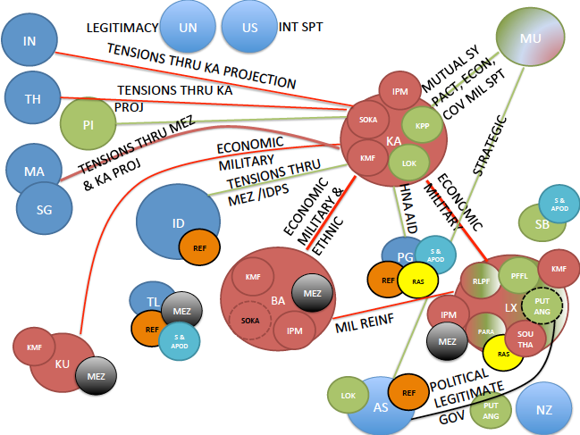

Slide 63
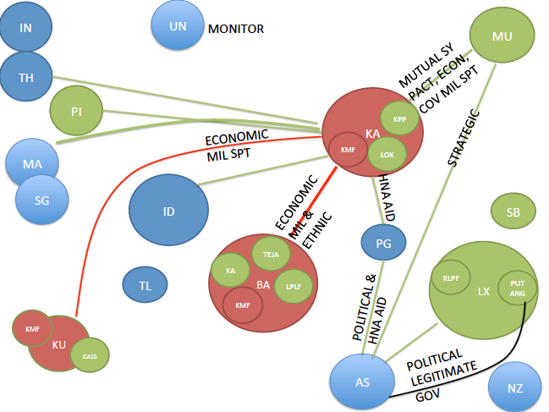

Slide 64
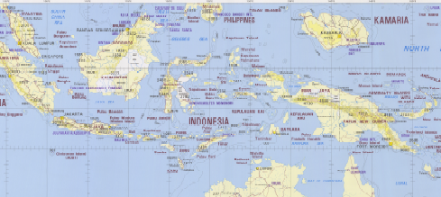
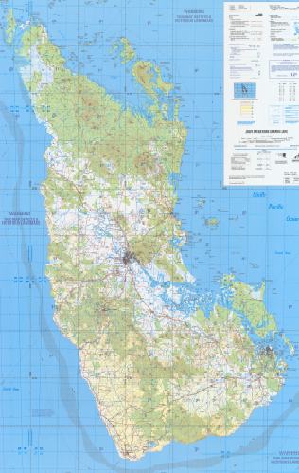
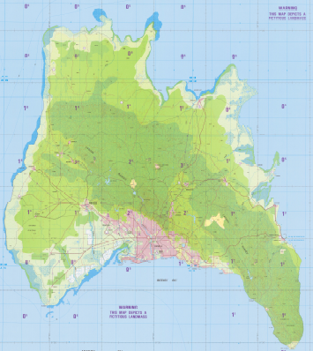
IN
PI
M
TH
MA
KA
SG
SB
PG
S
ID
Ra
I
BA
TL
KU
LX
LEGAIS
I
I
Pu
I
I
K
KMF
R
RLPF
I
K
I
IPM
T
TEJA
Ra
So
L
T
S
I
S
KA SOF
k
KA ETHNIC
S
L
K
S
Pa
PARA
Ra
RASCALS/CRIM
K
I
I
Ra
R
I
k
I
K
Pa
T
P
PFFL
I
IDPS/ REF
R
K
S
k
Ra
L
I
K
I
K
L
LBLF
Pu
PUTANGA
S
P
R
I
So
SOUTHA
K
I
BAYKARA
R

Slide 65
IN
PI
M
MA
S
TH
K
I
SG
SB
PG
ID
BA
TL
KA
LX
LEGAIS
K
KMF
R
RLPF
Pa
I
IPM
T
TEJA
Pu
I
T
Pa
S
SOKA
KA ETHNIC
k
Pa
Pa
PARA
Pu
PUTANGA
I
R
k
k
Pa
T
P
PFFL
I
IDPS/ REF
Pa
L
LBLF
R
I
BAYKARA
R

Slide 66
ACSC Operational Design Guide
CURRENT SITUATION
LINES OF OPERATION
OPERATIONAL OBJECTIVES
CAMPAIGN OR OPERATIONAL END STATE
MILITARY STRATEGIC END STATE
NATIONAL STRATEGIC END STATE
What are the current conditions?
What does the operating space ‘look like’?
Is there a problem?
What is the problem?
What do we need to change to achieve the end state?
What needs to stay the same?
The alignment or grouping of decisive points results in developing lines of operations, which connect the decisive points over time and space towards the operational objective.
The overall end state may be too broad or vague to deal with, therefore, it can be broken into smaller elements that can be described separately (mini end states). These are operational objectives. The achievement of the sum of the operational objectives results in the achievement of the end state.
Determining the campaign or operation end state involves analysing the superior commander’s intent and national or military strategic objectives
A clearly defined end state promotes unity of effort, facilitates integration and synchronisation and helps manage risk..
Military strategic end state is the set of desired conditions beyond which the use of military force is no longer required to achieve national strategic objectives.
DESIRED END STATE:
What is the overall national aim?
What are the national policies?
DESIRED END STATE:
What does the operating space ‘look like’?
What are the conditions necessary to achieve the goals?
What needs to change and what needs to stay the same?
A line linking decisive points to allow sequential progression towards an operational objective or the desired end state.
A condition that needs to be achieved during a campaign or operation to enable the desired end state to be reached.
The political and/or military situation to be attained at the end of a campaign or operation, which indicates that the objective has been achieved.
PMC (Prime Minister & Cabinet)
JOC (Joint Operations Command)
POL OBJ
POLITICAL STRATEGIC ENDSTATE
What is the right problem to solve?
What is the aim – environment & actors?
Frame the problem
OBJ
Decisive Points
Lines of Operation
POL OBJ
CURRENT MILITARY SITUATION
1
2
3
4
OP OBJ
OBJ
Effects = Task and Purpose for a tactical outcome
MSC (Military Strategic Commitments)
5
2
6
7
8
OP OBJ
OPERATIONAL ENDSTATE
MILITARY STRATEGIC ENDSTATE
OBJ
GRAND / COALITION / NATIONAL STRATEGIC ENDSTATE
Effect (task and purpose)
Effect (task and purpose)
Effect (task and purpose)
Sequel
13
14
15
OP OBJ
OBJ
Commander’s Decision Point
3
9
10
11
12
OP OBJ
Branch
ECONOBJ
ECONOMIC STRATEGIC ENDSTATE
OBJ
16
17
18
ECONOBJ
OBJ
DECISIVE POINTS
In planning there are conditions that must be set in order to realise the end state and/or the operational objectives. These conditions are the decisive points. In articulating decisive points, think in smaller tangible conditions that build and thereby lead to the operational objective and thence end state. You must plan to achieve the decisive points – allocate resources effectively – needs to take into account risk, branching, sequencing. Analysis of decisive points will determine: What effects are needed – what do you need to do to change the conditions? What capabilities are needed to achieve the effects? When the effects are needed by? Threats to achieving the desired effects? This leads to tasks to components, or joint capabilities.
Must be measurable; distinguishable; linked directly to objective/s. Effects are subsets of DPs and articulate ‘task and purpose’ to subordinate formation/s. DPs are things that you are willing to contest, to fight for…
BRANCH
SEQUEL
CENTRE OF GRAVITY (COG)
MAIN EFFORT
An option at a Commander’s Decision Point (CDP) along a line of operation that allows the commander flexibility to anticipate decisive points by deviating from, and returning to, that line of operation.
An option at a Commander’s Decision Point (CDP) along a line of operation, initiated by a significant shift in operational direction, which identifies a new line of operation to achieve a revised or new objective.
The primary entity that possesses the inherent capability to achieve an objective otr the desired end state.
Thing or those things (noun) that enable an actor to achieve their end state or stop others achieving theirs.
There can be more than one CoG.
All actors potentially have CoG.
A concentration of forces or means, in a particular area, time and phase of an operation, where a commander seeks to bring about a decision.
The ME may be a DP or the main LOO during that particular phase. It is what the commander thinks is going to be decisive and it provides the focus for the activity that is considered to be crucial to success in the campaign or operation …
A significant operational milestone that exists in time and space or the information domain which constitutes a key event, essential task, critical factor or function that, when executed or affected, allows a commander to gain a marked advantage, or contributing to achieving success.
References:
1. Department of Defence, ADDP 3.0 Campaigns and Operations, Edition 2, 12 Jul 12, Defence Publishing Service, Canberra, ACT.
2. Department of Defence, ADDP 5.0 Joint Operations Planning, 2014, Defence Publishing Service, Canberra, ACT.
3. Department of Defence, ADFP 5.0.1 Joint Military Appreciation Process, Edition 2, 24 Feb 15, Defence Publishing Service, Canberra, ACT.
Version: 4
Author: JOP Team

Slide 67
Operational Approach – NORTHCOM PE
Conditions
Endstate
ENDSTATE
Partnership With Mexican Security Forces
Mexican Security Forces seen as legitimate by the people
People are able to conduct daily activities without fear of Cartel intimidation/ violence
Environment is no longer permissive for Cartels, FoM denied
Economy provides opportunity and social mobility for the populace
Effective Government leaders represent the needs of the people and act on their behalf
Corrupt Officers Removed
Habitual Partnerships Established
New Recruitment Drive
Mexican Security Forces Better Paid
Security Forces target Cartel Violence
Media Embeds w/ operations
Exploit Successful Ops
Security
Secure Border
Partnered Agency Support
Neutralize US Gangs
Media Exploits US success
Mexican Support
Stand up Neighborhood Watches
Neutralize Mexican Gangs
Cartels are unable
to maintain freedom
of maneuver, the
border is secured,
and the populace
views local
government as
legitimate and is
able to lead daily
lives without fear
from Cartel violence
Cartel Interdiction
Interdict Smuggling Routes
Exploit Gang Tensions
Target Money Laundering Ops
Key Leadership Removed
Partner w/ Community Leaders
Media Campaign
Amnesty / Repatriation for Gang Soldiers
Economic Development
Right to Work Program
Illegal Economy Interdiction
Infrastructure Dev.
Guest Worker Program
Stand up Neighborhood Watches
Governance
Establish Juarez/El Paso DRTs
Targeting Focus on Corrupt Leaders
Call Special Election
Extradition Agreement for Trial in US Courts
Establish Fair Mexican Judiciary
Partner to Build Special Joint Prosecutor for Narco-Violence

Slide 68
Operational Approach – CENTCOM PE
ENDSTATE
Conditions
Kurds hold Kobane
ISF seize Tikrit w/ US Sup
ISF Seize Mosul w/ US Sup
Someone seizes Raqqa
Key Terrain not in ISIL control
Ceasefire in Syria between FSA and SAA (partition or federal system)
Flow of Foreign Fighters stopped
Sunni/Kurd/Shia Political Solution
In Iraq that Sunnis believe in
Destruction of ISIL Economic Infrastructure
Stop Bombing JAN
Gulf States Support
Turkish Support
Iranian Support
Gulf States/Turkey force FSA
Alawites Agree to terms
Crackdown of Radical Clerics
Turks secure the border
Counter Propaganda
ISIL Military Defeats Exploited
GOI/Kurd Oil Agreement
GOI gives Kirkuk to Kurds
GOI Disbands Shia Militias
GOI rapprochement with Sunnis
Intl Agreement on Ransoms
Crack down on Artifact smuggling
Focus Bombing on Economic rather than military assets
ISIL loses control of Oil and Cities

Slide 69
ISR / Detect
Deny
Secure
1
Sec LX, Deter FPDA Lodgement, HA Enabaled
4
6
8
Ins Defeated
9
14
2
HA Enabled
4
6
9
14
10
7
3
FPDA Lodgment deterred
1
2
1
2
3
5
13
14
SQ1
FPDA Land Forces defeated on LX
11
1
12
15
CDP 1: UNSCR SIGNED CDP 2: MARSTK Failed
No: | Decisive Points
1 | Situational Awareness established | 6 | Local pop centres secured | 11 | KMF further reinf with Airborne Inf
2 | Local Air Superiority established | 7 | Diversionary Effects | 12 | Air Control re-estb LX
3 | Local Sea Control established | 8 | PFFL IO Campaign countered | 13 | FPDA ATG Deterred
4 | MEZ Enforced | 9 | Insurgency neutralized | 14 | Local Security Established
5 | LX Defences hardened | 10 | KMF Reinforced with Mech Inf | 15 | FPDA Land forces neutralized

Slide 70
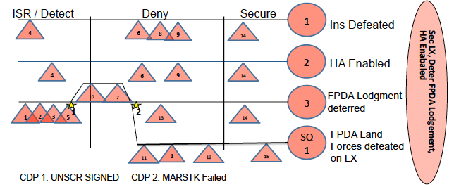
EN MLCOA
P: Deny FPDA a foothold on LX.
M: Primarily by deterrence or MARSTK, but could be by Land engagement of FPDA forces.
E: LX remains in KA control and provides resources to KA.
PH 1 ISR / Detect
ME: Mar Surv of likely approaches
SE: CAP, Hrdning def, Diversions
PH2 Deny FPDA Lodgement
ME: Deter or MARSTK of FPDA ATG
SE: ISR, CAP, Sea Control
PH3 Secure LX
ME: Neutralize FPDA Land Forces
SE: Air Spty, Sea Control
IPM / SOF
7
X(-)
10
11
ssg
10
7
A
IPM
IPM
ssg
7
A
ssg
13
ssg
IPM
1
4
IPM (DN, TVL)
MTF
7
2
S
S
DP List:
SA Est’d
Local Air Spty
Loc Sea Ctrl
MEZ Enforced
Def Hrdn’d
Loc Pop Scr’d
Diversions
PFFL IO countered
Insurgency neuatralised
KMF Reinforced Mech
KMF further reinforced
Air control re-est
FPDA ATG Deterred
Local Sy established
FPDA Land forces neutralised
LLoO Diagram

Slide 71
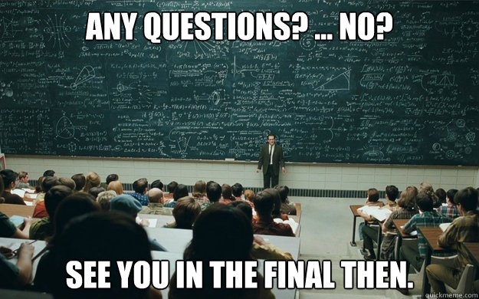
Questions

